Slide 1
Archiving Stuff
Acquiring Information using Visual Analytics
Dave Kasik
Senior Technical Fellow
The Boeing Company
david.j.kasik@boeing.com
June, 2011
Dave Kasik
Senior Technical Fellow Emeritus
The Boeing Company

Slide 2
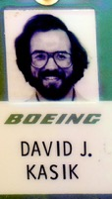
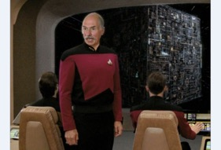
About Me
Involved in computer graphics since 1969
Attended all North American SIGGRAPH conferences
Retired Boeing Senior Technical Fellow
ACM Fellow
General curmudgeon about over-promising and under-delivering
Stand-in on starship bridges
Then
Now

Slide 3
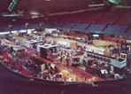
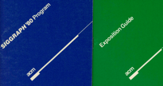
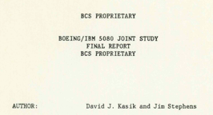
What Makes Stuff Interesting?
It’s all a matter of your perspective
Interesting examples in my stuff
All technical papers from SIGGRAPH 1974
Attendee list from SIGGRAPH 1975
Collection of shaded images circa 1974
Proposal for ‘The Electric Picture Company’ 1973
Pictures of exhibits, 1980
Results of Joint Study on 5080, 1983
Less interesting
Complete collection of SIGGRAPH proceedings
SIGGRAPH pins, ribbons, cups, T-shirts
3

Slide 4
Caveats
Pay attention to proprietary markings
Sift through stuff multiple times
Do sifting sooner rather than later
Donate when you want

