Slide 1
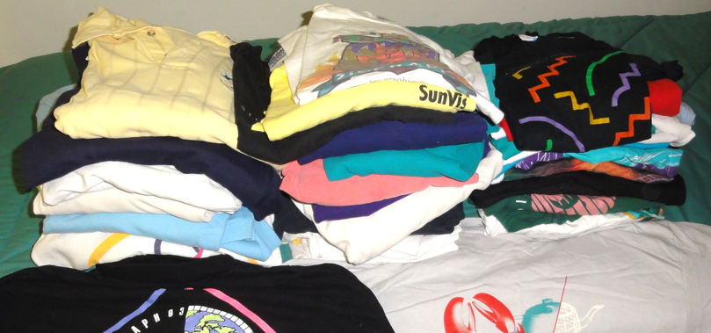
ACM SIGGRAPH History Committee
Mary Whitton, Chair
Notes:
Thank you all for joining us…. A little bit about committee’s work and then some confessions of a pack rat

Slide 2
Mission: Collect and Preserve,
Make Materials Accessible; Document Impact
ACM SIGGRAPH HISTORY COMMITTEE
Encourage Histories that will
Document, Teach, Inspire
The scope is huge; we need many hands
Notes:
WHY NOW

Slide 3
Why Now?
People who made
the history die
Video tapes and films
fade and crumble
Boxes and files will
get thrown out
RIP
Swag is fun, but less perishable

Slide 4
History committee activities
Building collections
Building infrastructure
Support preservation of personal collections
Notes:
COLLECTIONS TO AID HISTORIANS OF THE FUTURE
LA chapter archives
SIGGRAPH course notes
Interviews with pioneers
History of laboratories
INDEX to find; ONLINE/WEB repository and accessible archive
Taxonomy, graph based indexing
Web infrastructure :
SIGGRAPH history site
People behind the pixels

Slide 5
History committee activities
Building collections
  LA chapter archives
  SIGGRAPH course notes
  Interviews with pioneers
  History of research groups, development teams
    Corporate
    Academic
Notes:
COLLECTIONS TO AID HISTORIANS OF THE FUTURE
LA chapter archives
SIGGRAPH course notes
Interviews with pioneers
History of laboratories
INDEX to find; ONLINE/WEB repository and accessible archive
Taxonomy, graph based indexing
Web infrastructure :
SIGGRAPH history site
People behind the pixels

Slide 6
History committee activities
Building collections
Building infrastructure--ongoing
  Taxonomy, graph based indexing project
  Web infrastructure
    SIGGRAPH history site (reusing infrastructure from https://digitalartarchive.siggraph.org/)
    People behind the pixels (https://www.historyofcg.com)
  A formal archive? (big job)

Slide 7
History committee activities
Building collections (labors of love)
Building infrastructure
Support preservation of personal collections
  Identify who has what
  Help with what is important to save

Slide 8
Examples from a pack-rat
A two time entrepreneur
SIGGRAPH volunteer (many years)
Academic researcher

Slide 9
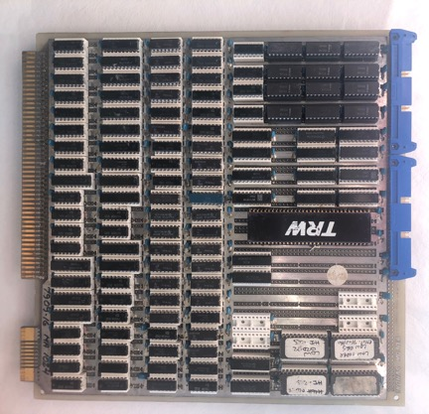
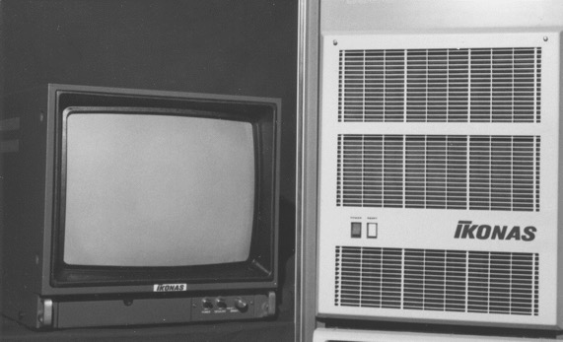
Entrepreneurial Pack Rat: Hardware
DESIGN DOCUMENTS and HARDWARE
Still working for 1998 25th conference exhibit!
~ 11” on a side

Slide 10
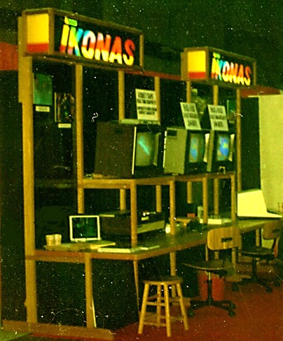
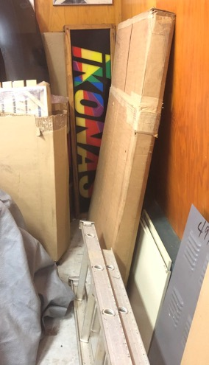
Entrepreneurial Pack Rat: Marketing
⬅Then
Booth fixtures
Now ➔
(Available if you’re decorating a dorm room)
Notes:
Brochures, advertisements. manuals, ⬅ can be scanned or maybe they were born digital

Slide 11

Entrepreneurial Pack Rat: Marketing
Yep, the parts are in our basement.
And there were
T-shirts
Brochures
Advertisements
Manuals
Easily photo- graphed, scanned
Notes:
Brochures, advertisements, ⬅ can be scanned

Slide 12
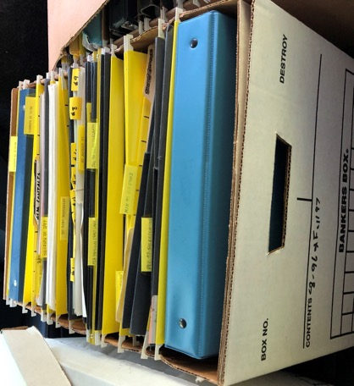
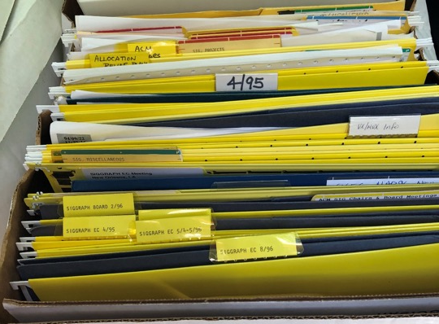
SIGGRAPH Volunteer Pack Rat: Records
Chair’s files: Executive Committee
Meetings
1990-1999
Period of huge growth

Slide 13
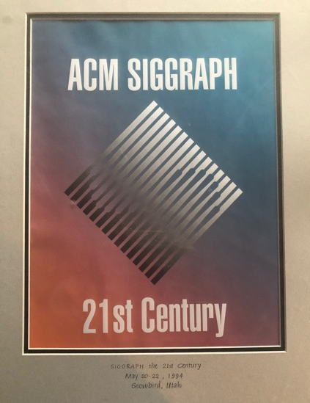


SIGGRAPH Volunteer Pack Rat: Events
Strategic Planning
1994 Workshop
Final report
Other ephemera
Event Photos-maybe

Slide 14
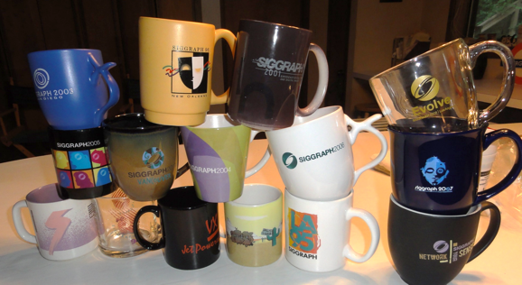
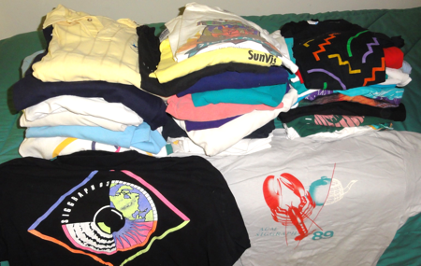
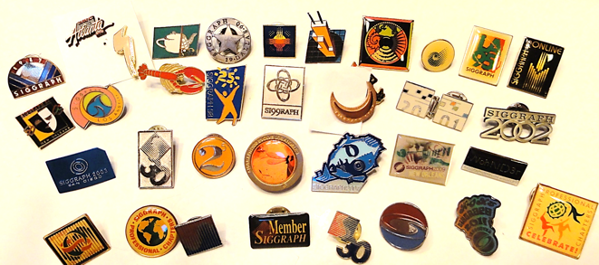
SIGGRAPH Volunteer Pack Rat: Swag

Slide 15
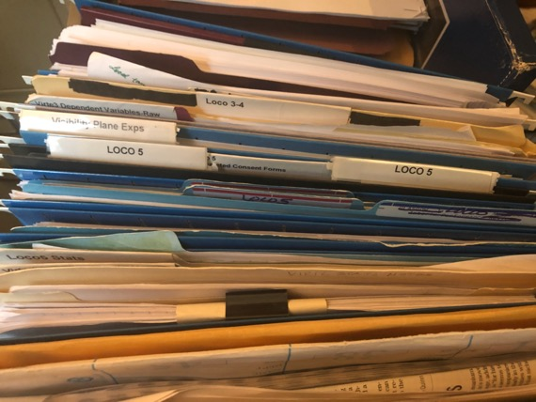

Researcher Pack Rat (Likely the hardest)
What’s important enough to keep?
  Did it win a big award?
  Was it first of a kind?
  Was it an important product?
Who wants it?
Hard call ; material is often part of who we are

Slide 16



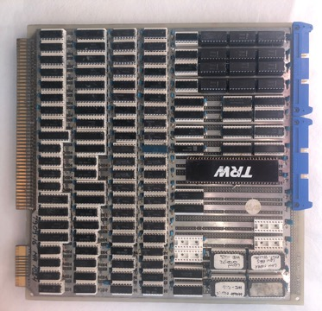
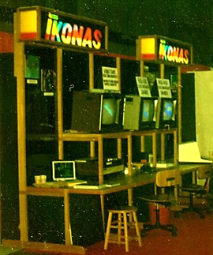

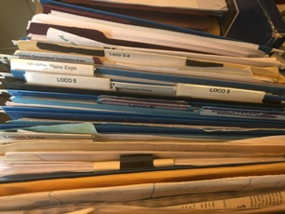
When you clean out an office/attic/storage bin, think before you toss things away . Call us. We’ll help.

